Slide 1
Critical Care Physiotherapy Documentation on Phillips ICCA – On Call Physiotherapy Staff
Emma Waring
Updated November 2025

Slide 2
Documents to complete
If a new admission:
PT: Initial Assessment
For each subsequent review:
PT: Ongoing Assessment and Treatment
If a full Ax or Rx is note required (e.g: If UTS, unavailable):
AHP progress Note

Slide 3
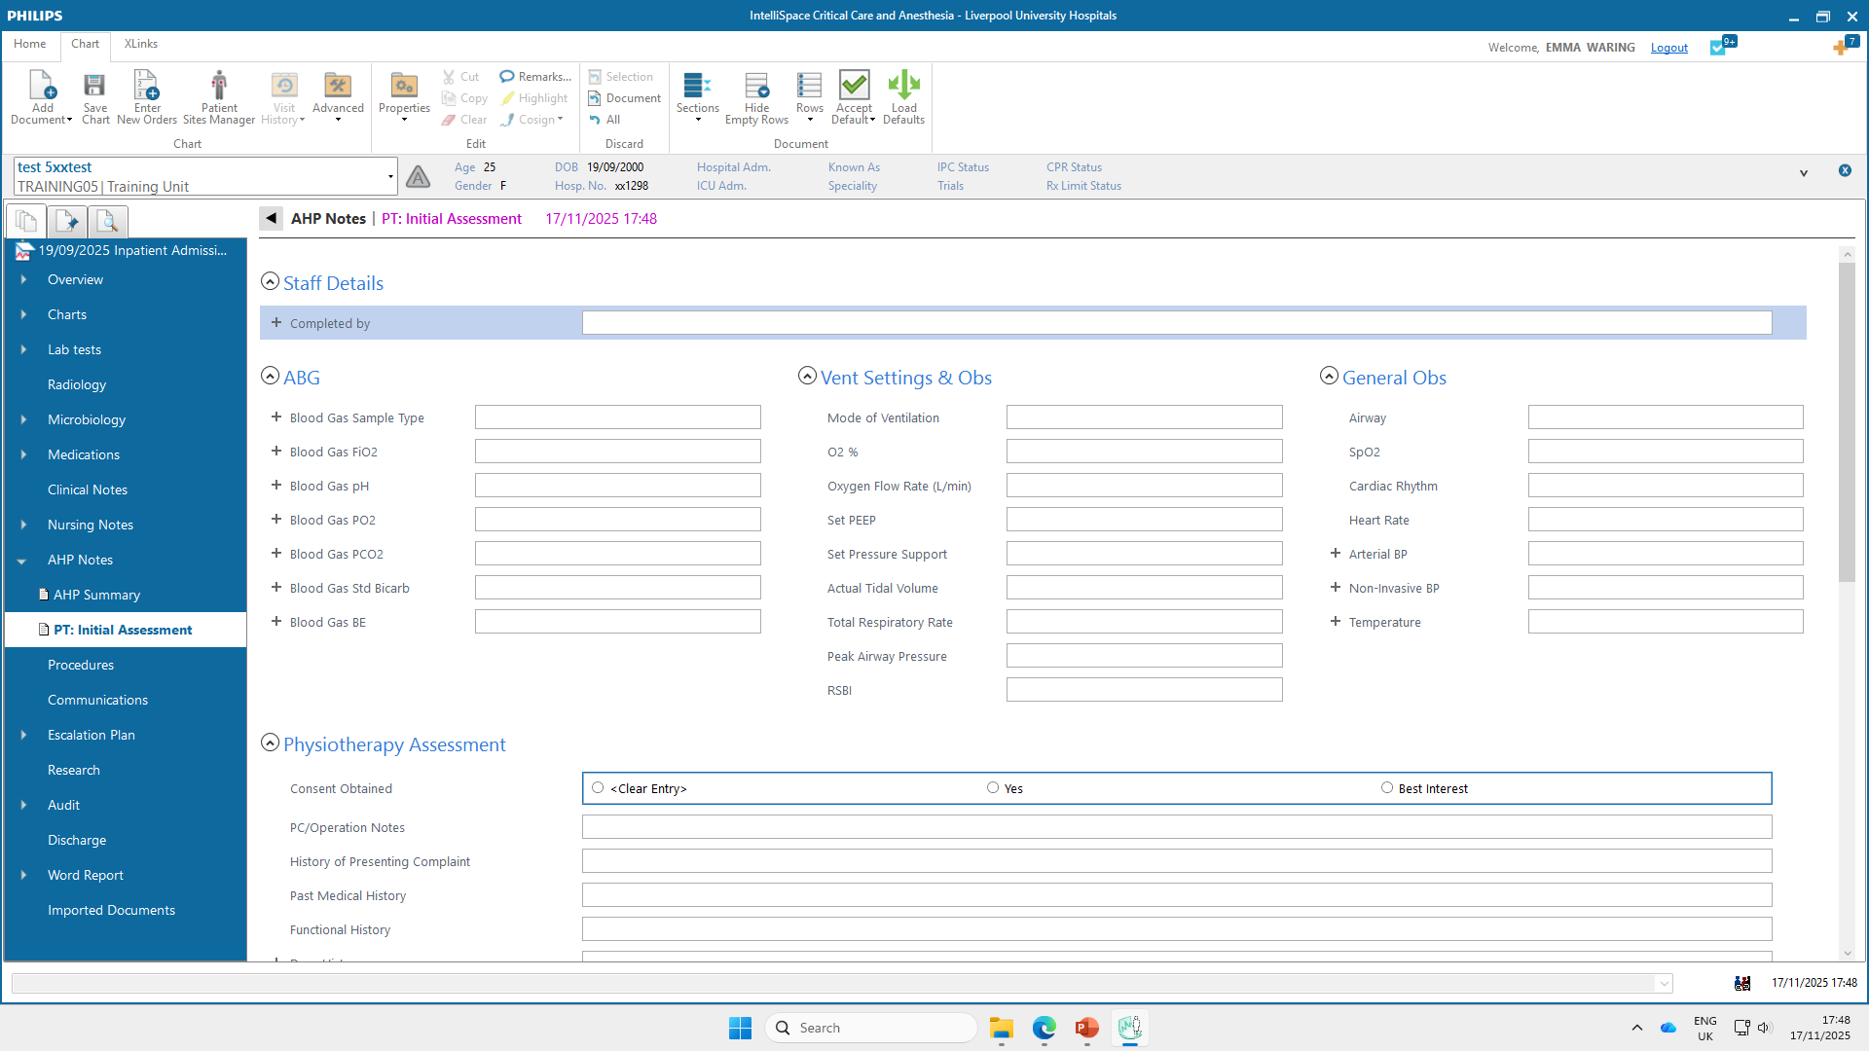
PT: Initial Assessment

Slide 4
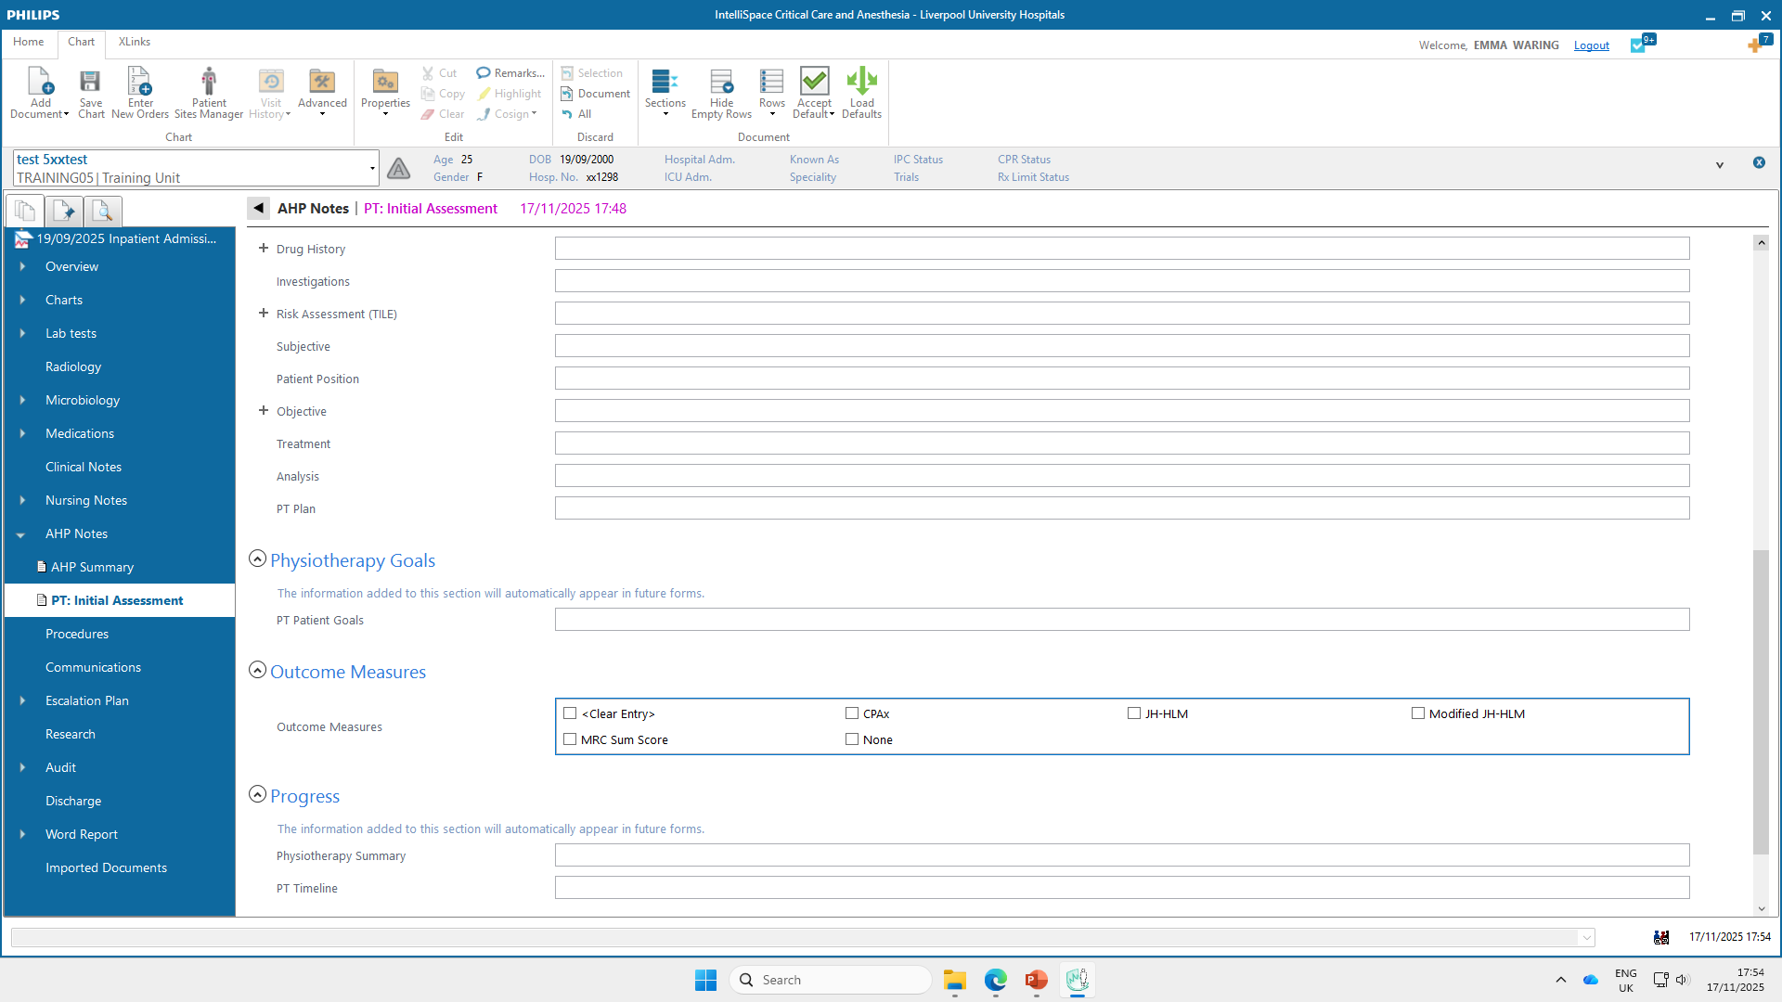
PT: Initial Assessment

Slide 5
Important notes
Useful documents to review prior to initial assessment include the Clinical Summary and Patient Profile in the Overview section. The Medical Admission and Daily Ward Round are also useful, found in Clinical Notes section
Observations will automatically populate and be shown in green until you have acknowledged them as correct, then they will turn purple. These should be checked, and additional info be added if appropriate
Remember – green or purple text means not saved – will only be saved if text is black
Some fields will automatically appear in future documents, so it is important to consider carefully what you add to these sections:
PT Goals (SMART, patient focussed)
Physiotherapy summary (brief summary of that session)
PT Timeline (Useful for weekend handover, limit to key events, keep brief)

Slide 6
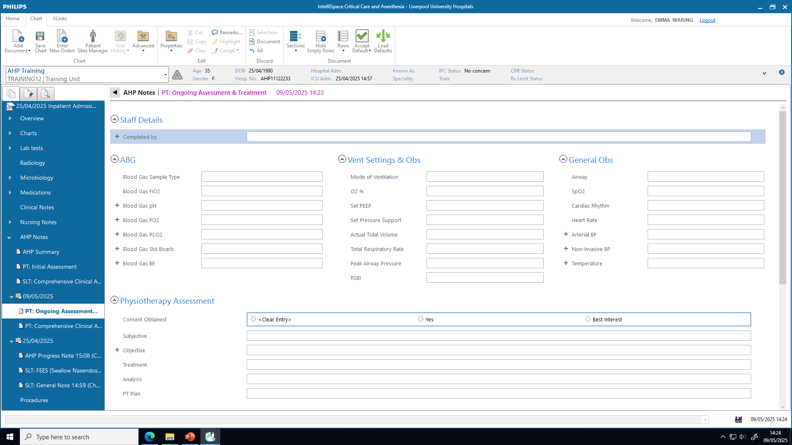
PT: Ongoing Assessment and Treatment

Slide 7
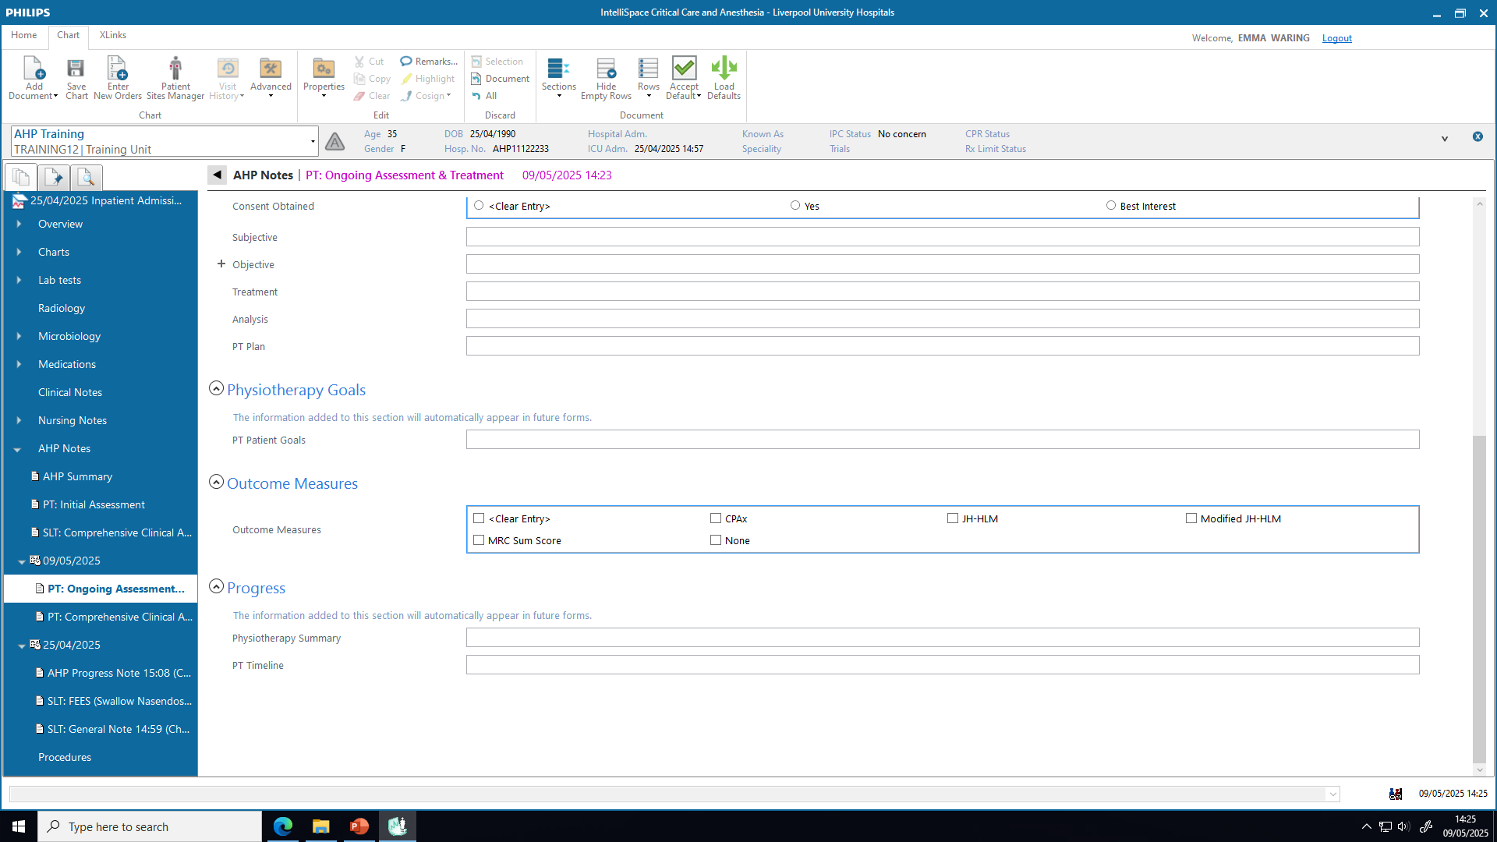
PT: Ongoing Assessment and Treatment

Slide 8
Important notes
Observations will be shown in green until you have acknowledged them as correct, then they will turn purple
Remember – green or purple text means not saved – will only be saved if text is black
Some fields will automatically appear in future documents, so it is important to consider carefully what you add to these sections:
PT Goals
PT summary
PT Timeline

Slide 9
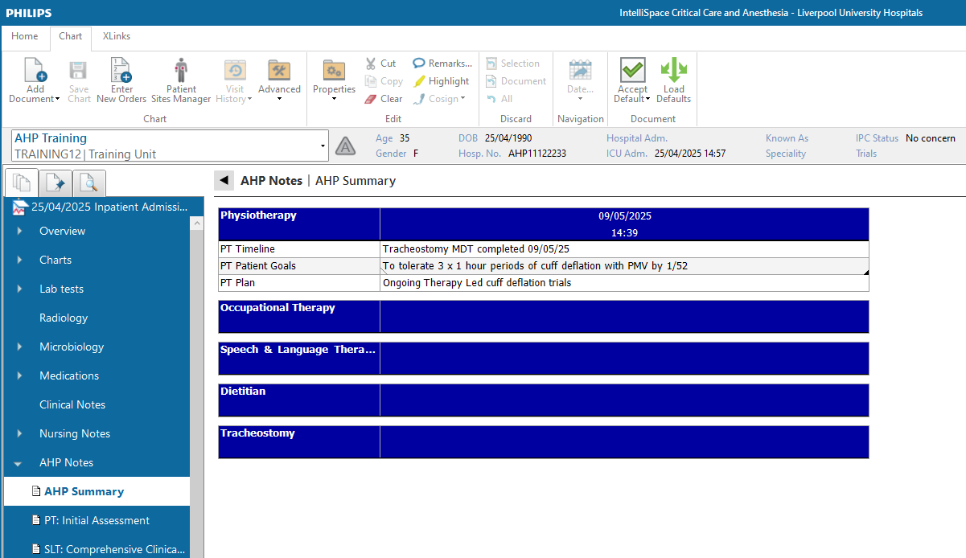
AHP Summary
Compiled from information inputted on previously completed documents
Separate handover also created on stepdown and included as PDF in PENS Discharge summary

