Slide 1
Critical Care Physiotherapy Documentation on Phillips ICCA
Emma Waring
Updated November 2025

Slide 2
Documentation Flowchart
On admission:
PT: Initial Assessment
Therapies Short Clinical Assessment
Is a Comprehensive Rehab Assessment triggered?
Complete PT: Comprehensive Clinical Assessment
Yes
No
Complete daily review on PT: Ongoing Assessment and Treatment
Complete daily review on PT: Ongoing Assessment and Treatment
AHP Progress Note available if does not require full assessment and treatment e.g: If UTS, unavailable
Monitor Rehab needs and repeat short clinical assessment on Therapies Short Clinical Assessment as appropriate
Twice Weekly Outcome measure and daily goals review on PT: Ongoing Assessment and Treatment
Weekly MDT (Friday) on MDT: ICU Therapies Weekly MDT (AUH)
Discharge Summary available on PENS post discharge via link with handover information.

Slide 3
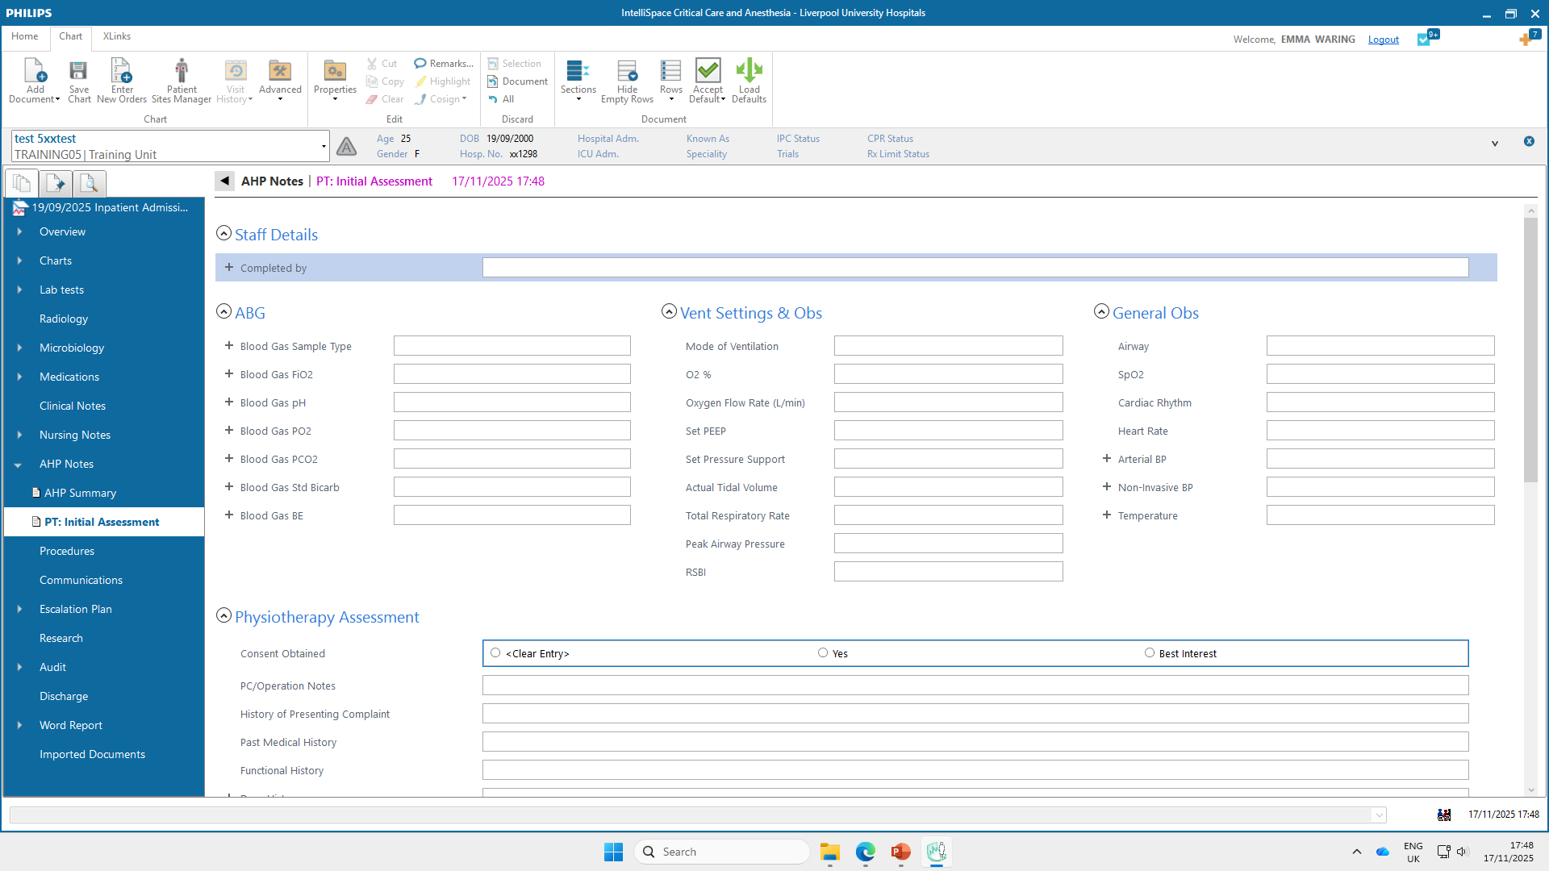
PT: Initial Assessment

Slide 4
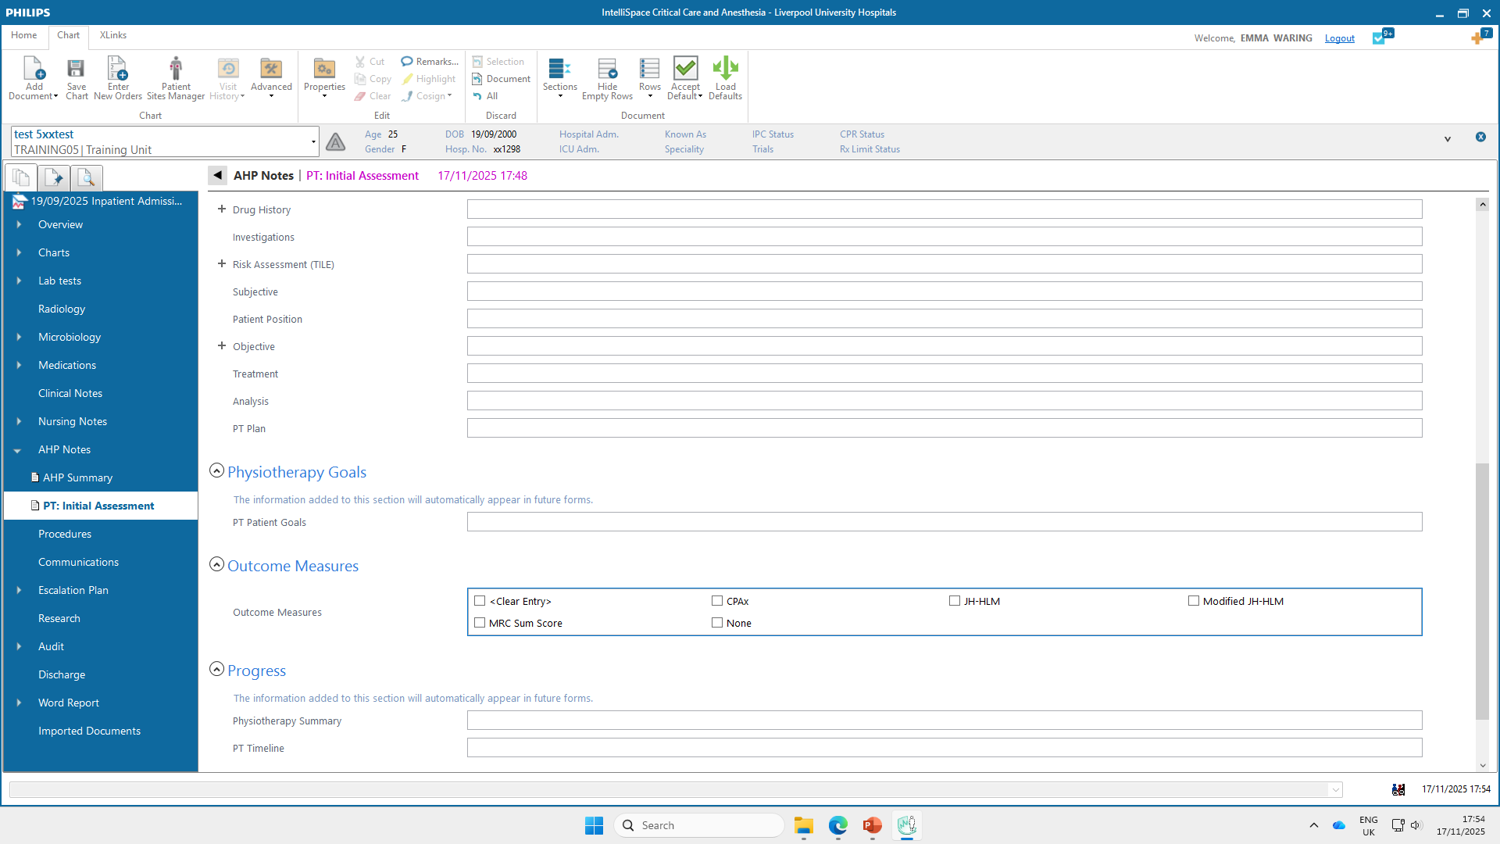
PT: Initial Assessment

Slide 5
Important notes
Useful documents to review prior to initial assessment include the Clinical Summary and Patient Profile in the Overview section. The Medical Admission and Daily Ward Round are also useful, found in Clinical Notes section
Observations will automatically populate and be shown in green until you have acknowledged them as correct, then they will turn purple. These should be checked, and additional info be added if appropriate
Remember – green or purple text means not saved – will only be saved if text is black
Some fields will automatically appear in future documents, so it is important to consider carefully what you add to these sections:
PT Goals (SMART, patient focussed)
Physiotherapy summary (brief summary of that session)
PT Timeline (Useful for weekend handover, limit to key events, keep brief)

Slide 6
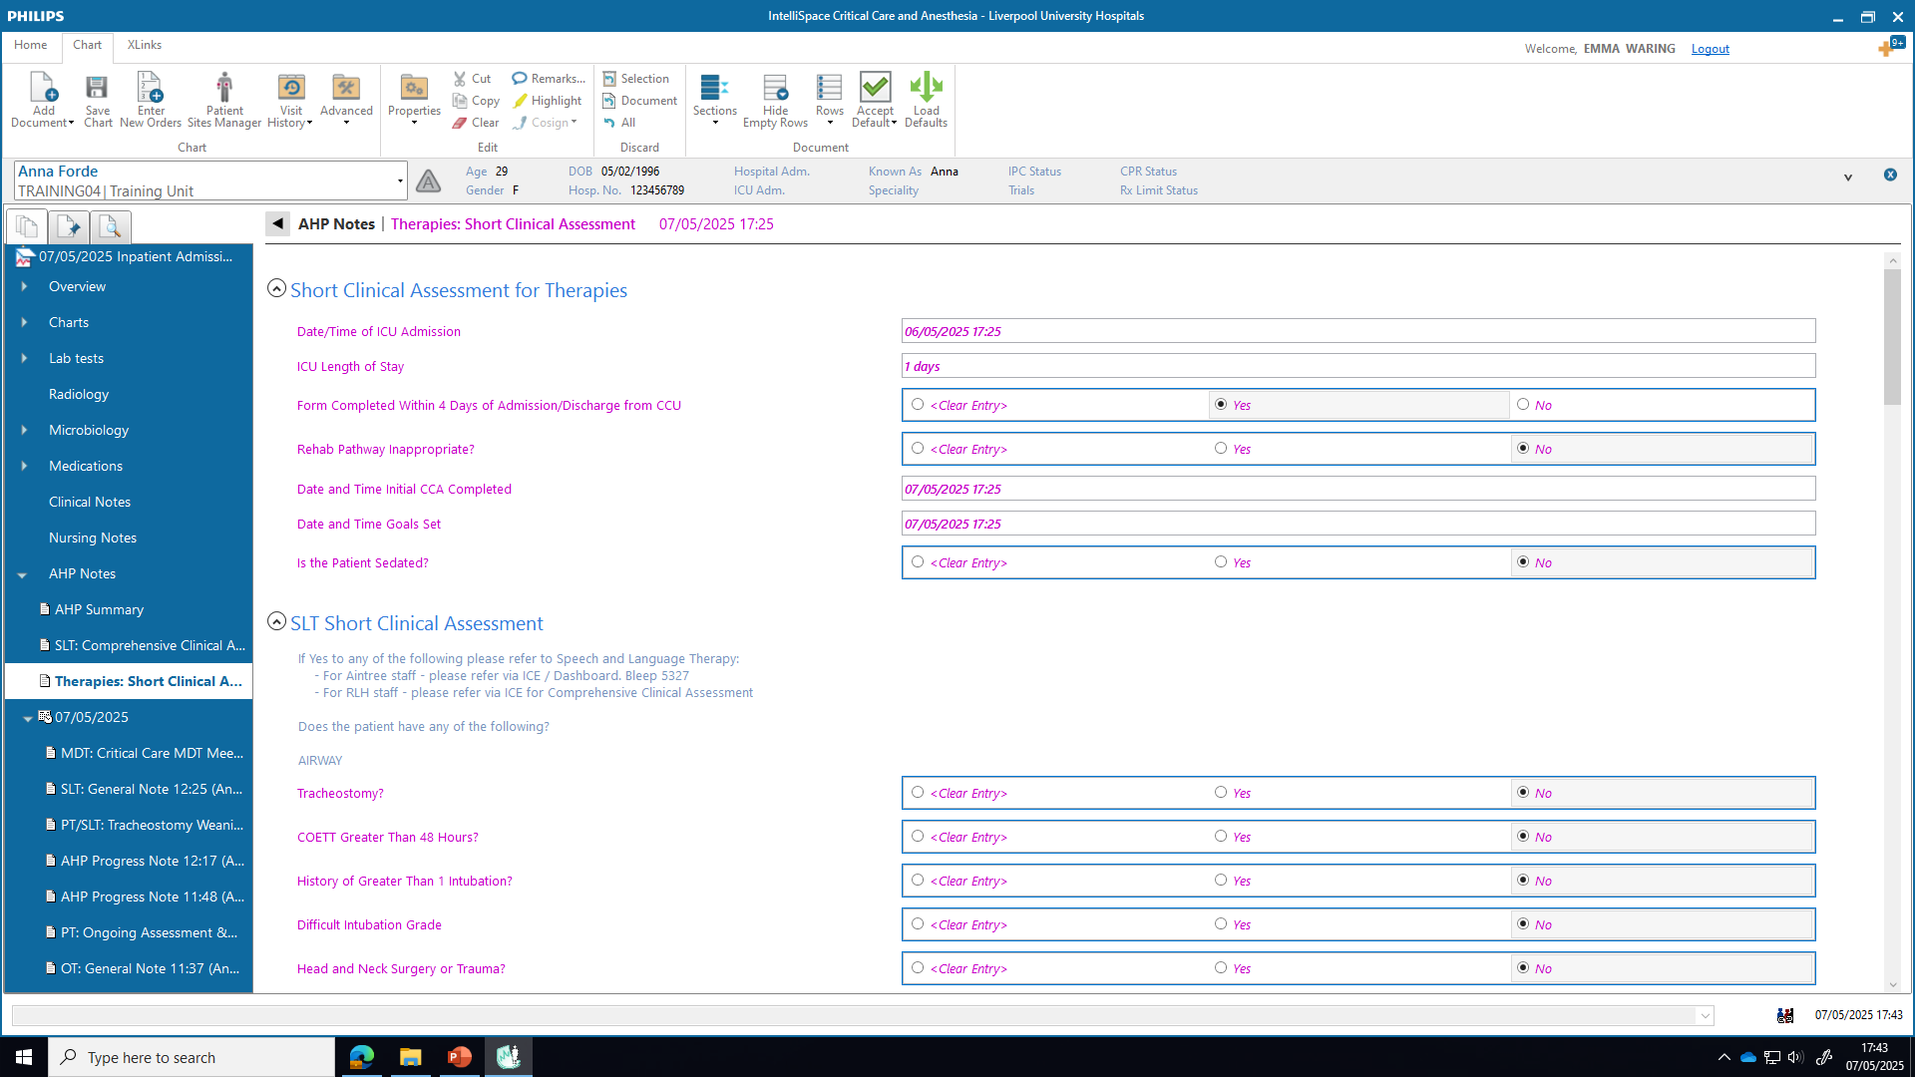
Therapies: Short Clinical Assessment (Admission)

Slide 7
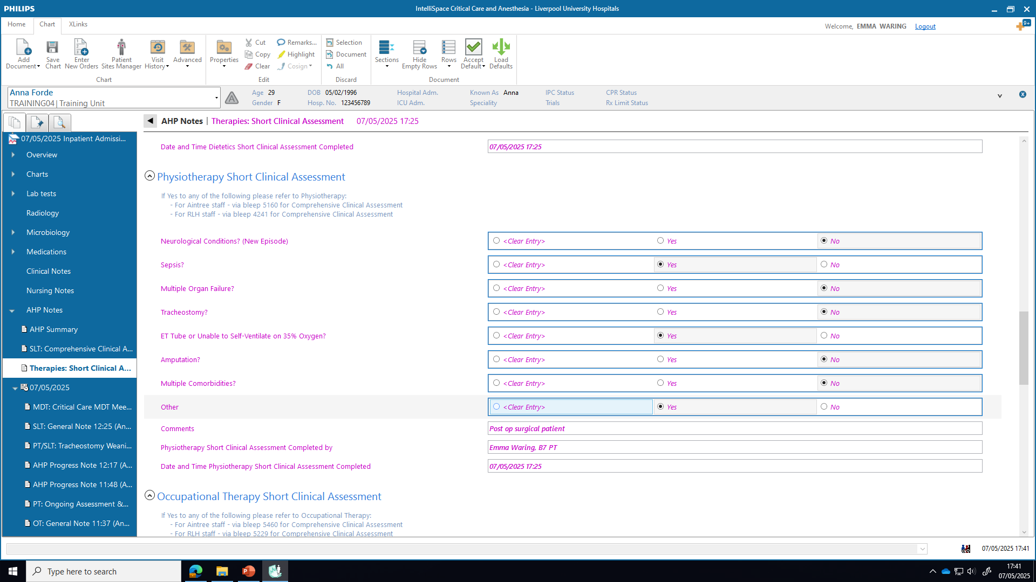
Therapies: Short Clinical Assessment (Admission)

Slide 8
Important notes
Remember – green text needs accepting, and purple text means not saved – will only be saved if text is black
Not currently completed on step down / discharge, as a PDF discharge summary is created which is accessible via PENS and serves as written handover

Slide 9
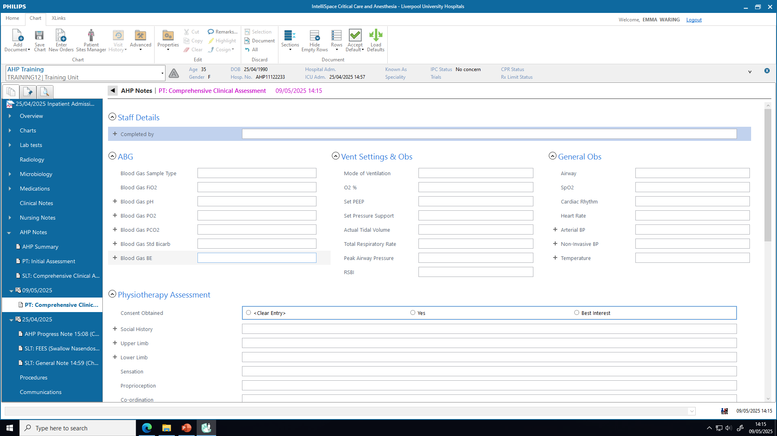
PT: Comprehensive Clinical Assessment

Slide 10
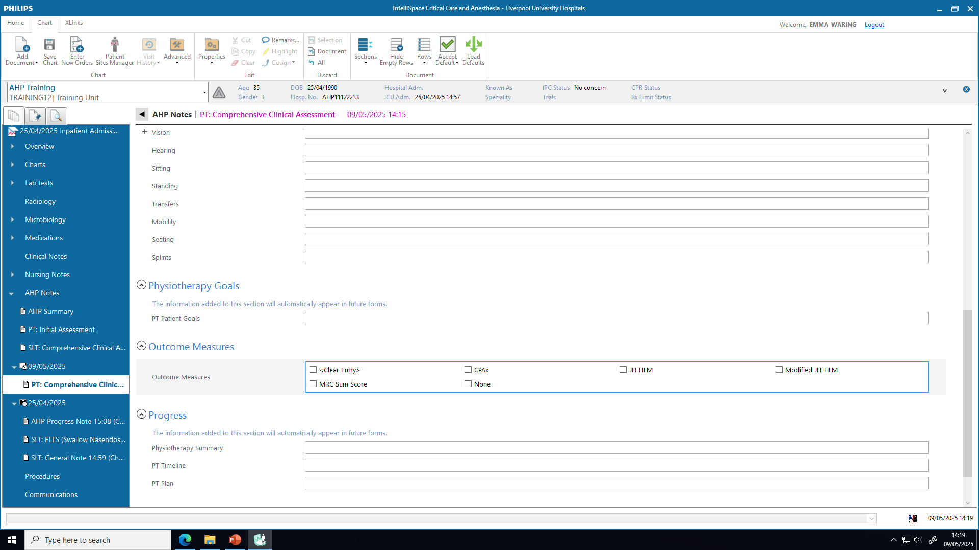
PT Comprehensive Clinical
Assessment

Slide 11
Important notes
Observations will be shown in green until you have acknowledged them as correct, then they will turn purple
Remember – green or purple text means not saved – will only be saved if text is black
Some information you complete here will automatically appear in future documents, so it is important to consider carefully what you add to these sections:
PT Goals
PT summary
PT Timeline
PT Plan

Slide 12

PT: Ongoing Assessment and Treatment

Slide 13
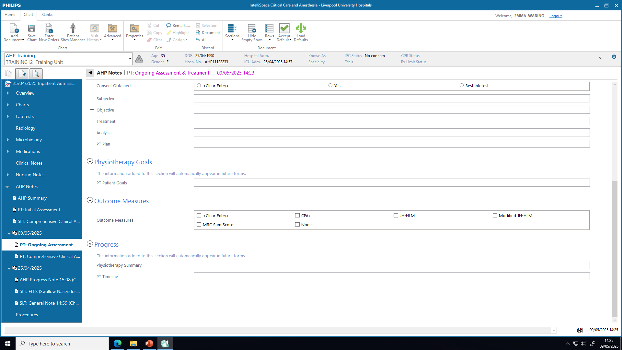
PT: Ongoing Assessment and Treatment

Slide 14
Important notes
Observations will be shown in green until you have acknowledged them as correct, then they will turn purple
Remember – green or purple text means not saved – will only be saved if text is black
Some fields will automatically appear in future documents, so it is important to consider carefully what you add to these sections:
PT Goals
PT summary
PT Timeline

Slide 15
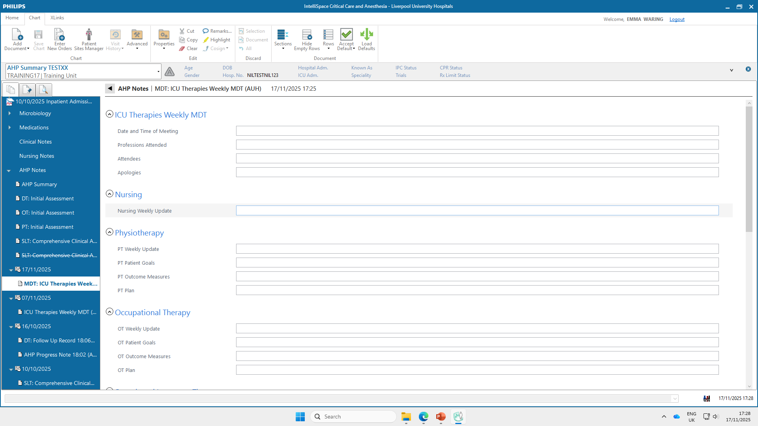
MDT: ICU Therapies Weekly MDT (AUH)

Slide 16
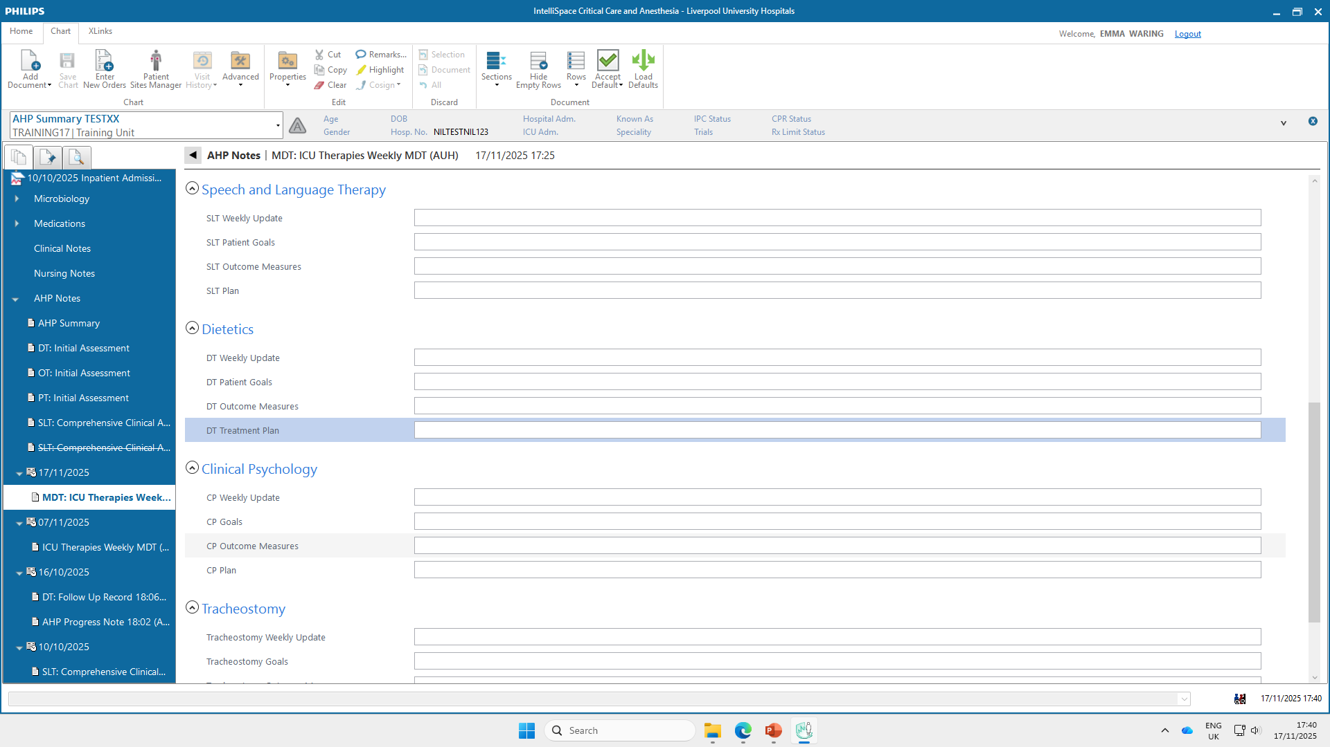
MDT: ICU Therapies Weekly MDT (AUH)

Slide 17

MDT: ICU Therapies Weekly MDT (AUH)
Professional weekly updates should be entered prior / during the MDT meeting
Goals and plans should automatically be pulled through from previously completed documents
Remember – green or purple text means not saved – will only be saved if text is black

Slide 18
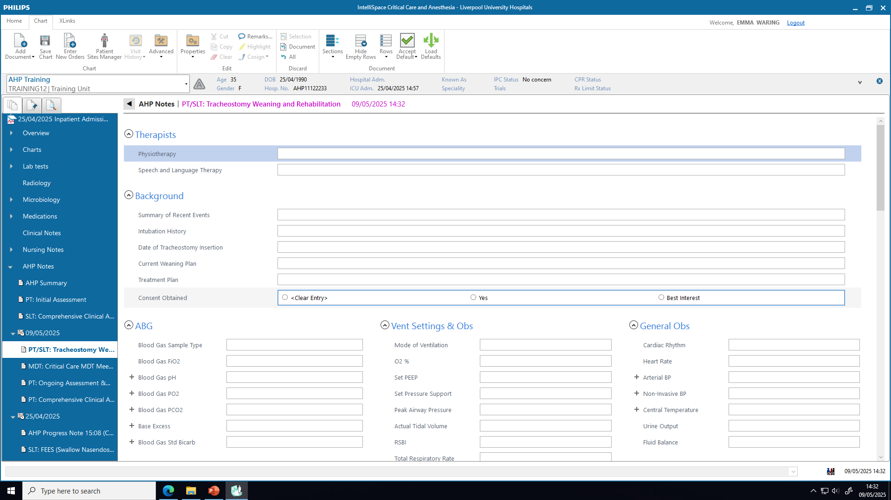
PT/SLT: Tracheostomy Weaning and Rehabilitation

Slide 19
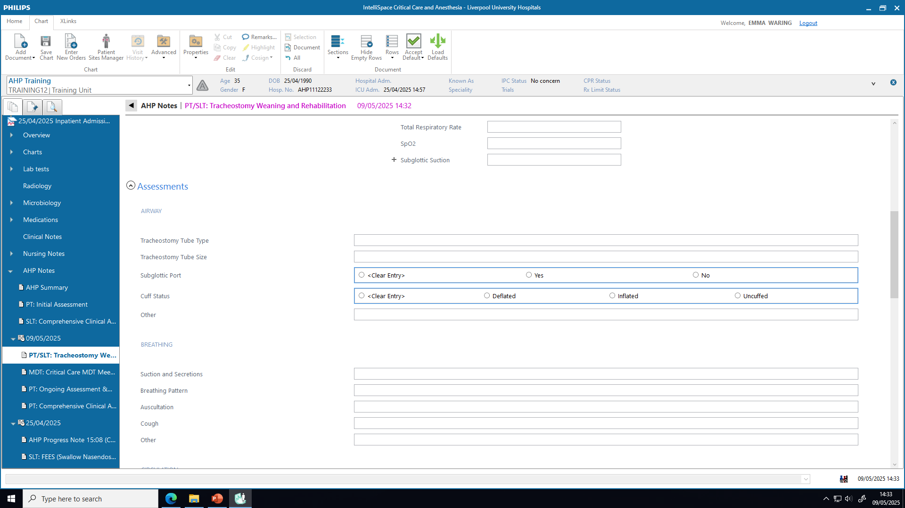
PT/SLT: Tracheostomy Weaning and Rehabilitation

Slide 20
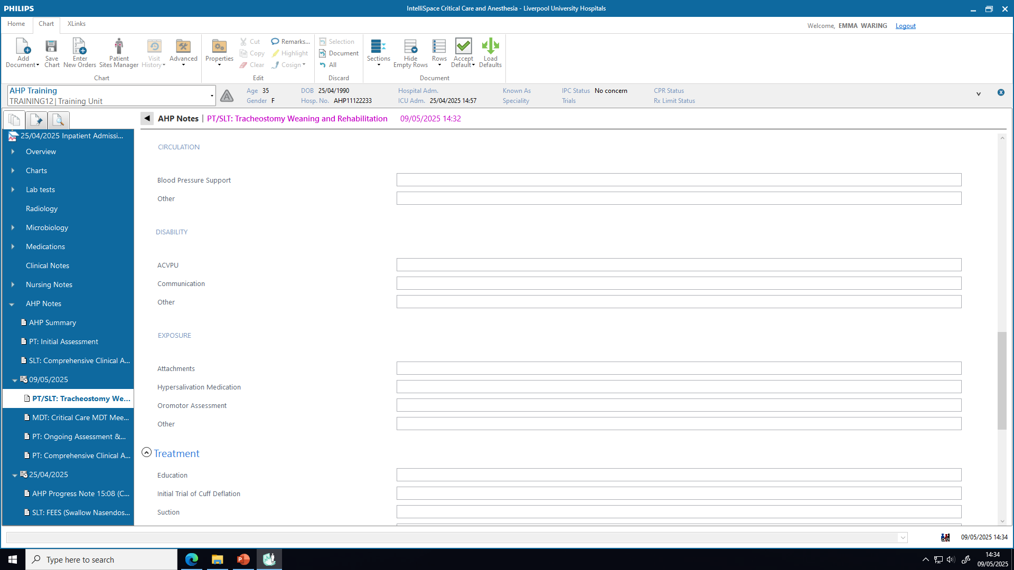
PT/SLT: Tracheostomy Weaning and Rehabilitation

Slide 21
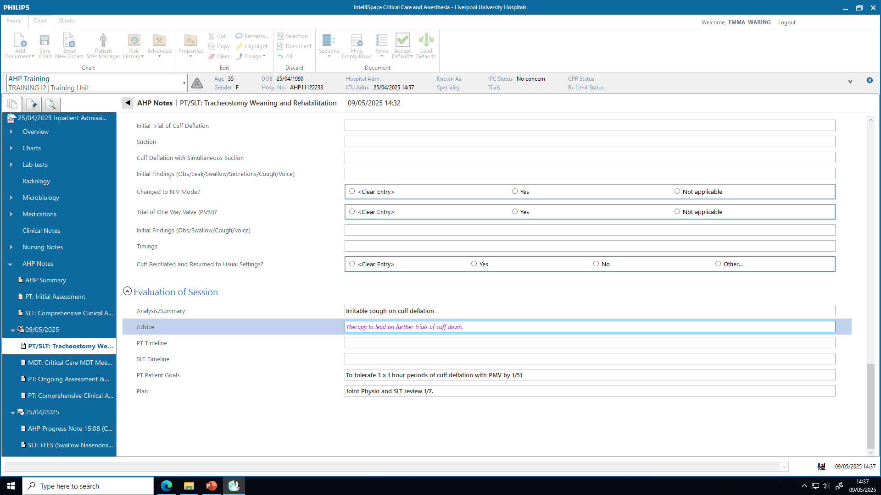
PT/SLT: Tracheostomy Weaning and Rehabilitation

Slide 22
Important notes
To be used at every Tracheostomy Weaning session to ensure appropriate info pulls through to future documents
Observations will be shown in green until you have acknowledged them as correct, then they will turn purple
Remember – green or purple text means not saved – will only be saved if text is black
Some fields will automatically appear in future documents, so it is important to consider carefully what you add to these sections:
PT Goals
PT summary
PT Timeline

Slide 23
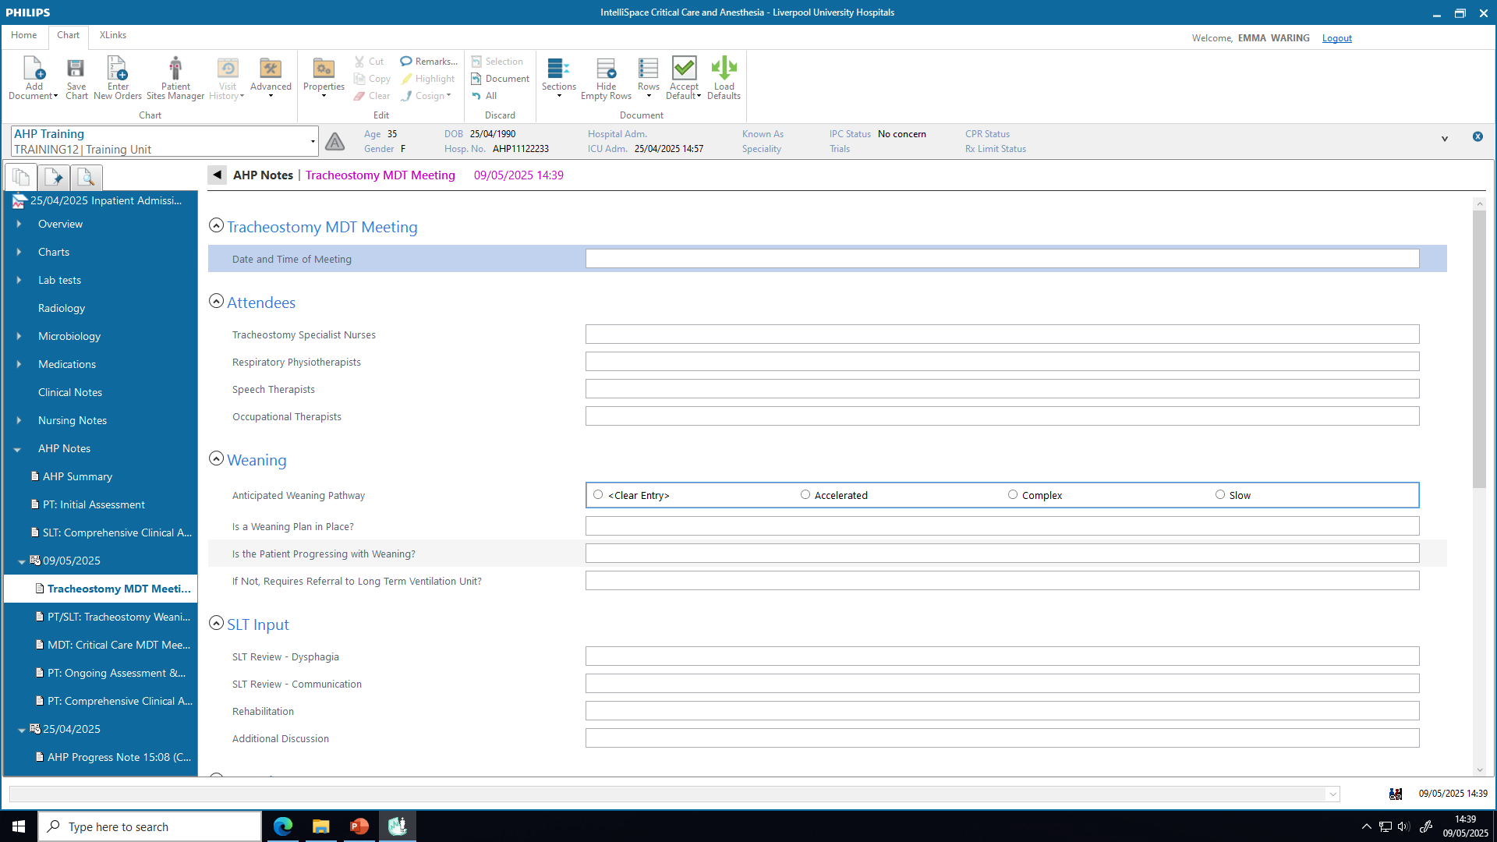
Tracheostomy MDT Meeting

Slide 24
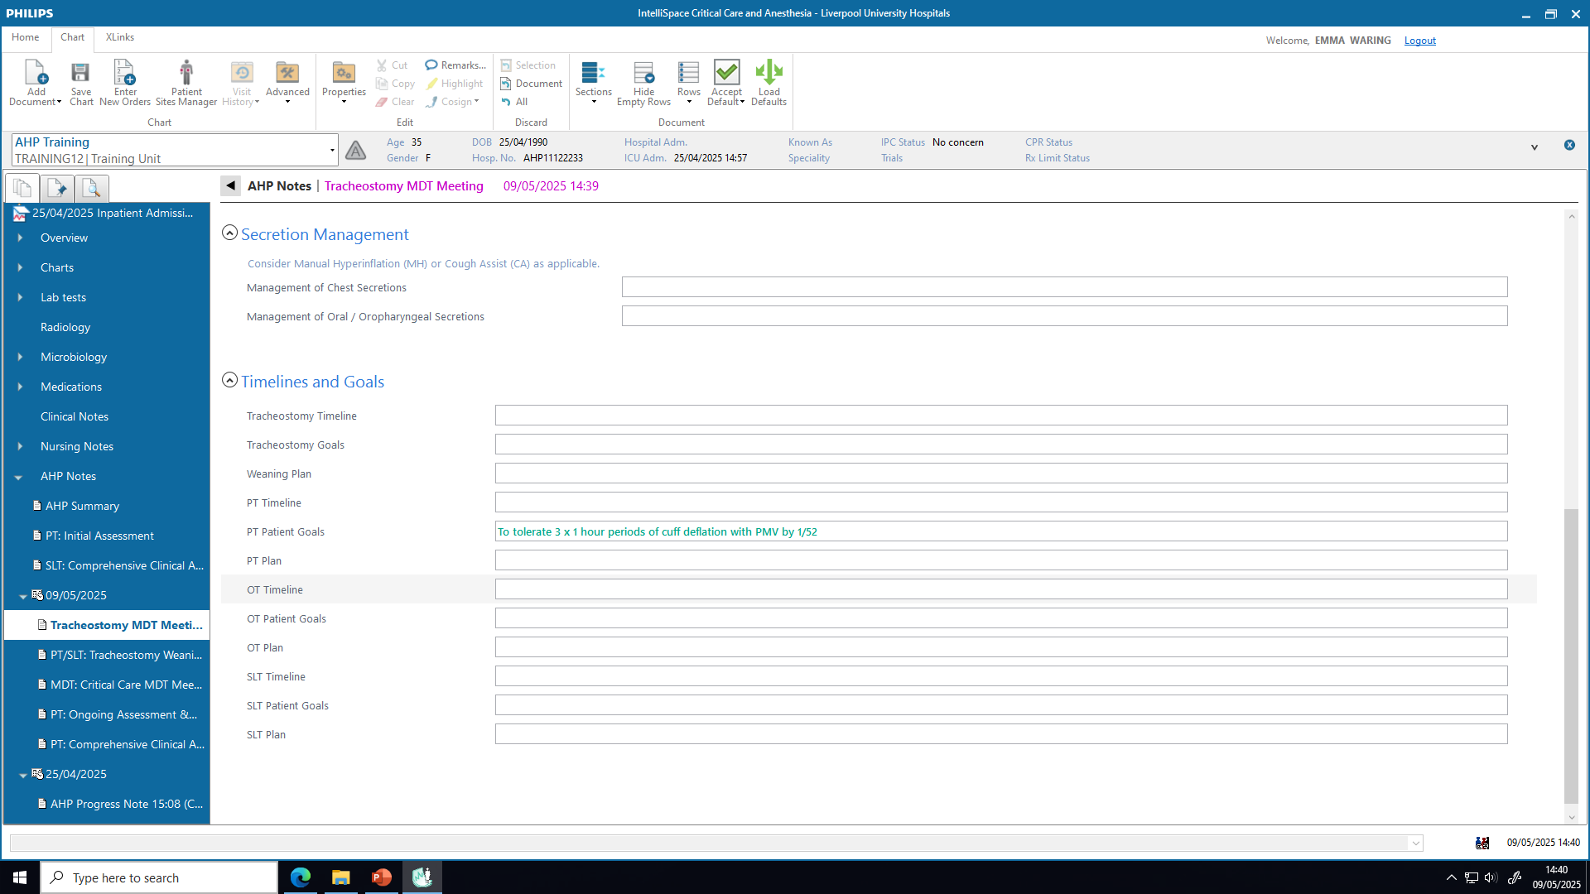
Tracheostomy MDT Meeting

Slide 25
Important notes
Information pulled across from other documents will appear green until you have acknowledged them as correct, then they will turn purple
Remember – green or purple text means not saved – will only be saved if text is black
Some fields will automatically appear in future documents, so it is important to consider carefully what you add to these sections:
PT Goals
PT summary
PT Timeline

Slide 26
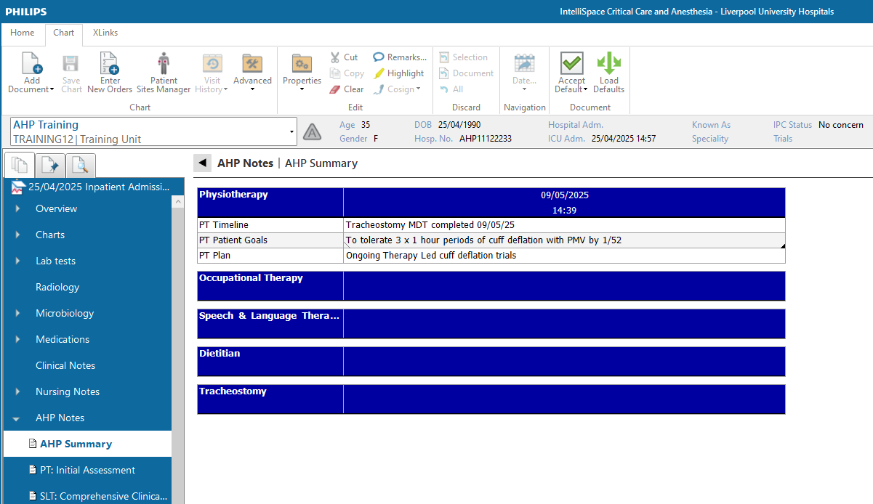
AHP Summary
Compiled from information inputted on previously completed documents
Separate handover also created on stepdown and included as PDF in PENS Discharge summary

